Slide 1

DevOps- Delivery matching with business speed

Slide 2
Dev Ops
DevOps ensures delivering frequent changes, with higher efficiency and robust quality based on market demands.
Faster Business changes
Ability to deliver the software matching with fastest changing business needs
Technology Changes
Accomading all new software's to automate and monitor the faster Delivery
Latest Infrastructure
Working with the latest saleable infrastructure like cloud base systems with AWS
Dev Ops

Slide 3



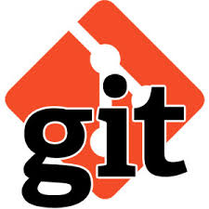
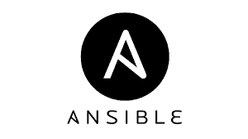
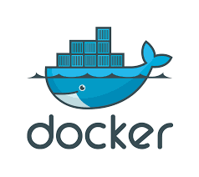
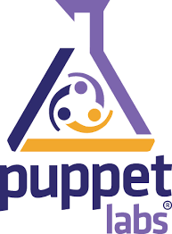





DevOps Overview
TOOLS
Commit Stage
Continuous Integration
Continuous Feedback
Fast Builds
Source Code
Source Code Repository
Environment & Application Config
QA
Acceptance
Stage
Automate Tests
Database Upgrade
Parallel Tests
Deployment
- Quality Assurance Deployment
Every Check-in
Deployment
UAT
Binaries
- Lockdown
Environments
- Parallel Tests
Metadata
Deployment
PRODUCTION
Artifactory Repo
- Blue-Green Deployments
- Rollback Release
Collaboration
Root-Cause Analysis

Slide 4
Challenges Of DevOps
Dev Ops Challenges
Who Owns What??
You have heard that DevOps is culture first. And while you know what culture means, it’s never clear who owns it.
Everyone has a tool
Tools can be adopted without any internal oversight, which can lead to issues down the road. Balancing tool delegation, which needs to happen, and tool management is something that needs to be addressed early on.
Cloud + Legacy
The reason operations don’t jump at tools at the pace that development and business users would desire, is not because they do not want to. Often it’s because that tool has to fit into an ecosystem of existing applications.
Networking
Networking, not servers, is often the immutable object that is not easy to make agile.
Who Owns Culture?
Everyone has a tool
Cloud + Legacy
Networking

Slide 5
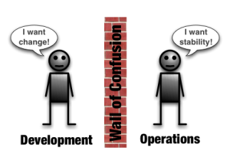
Why Dev Ops ?
There are separate and distinct groups for development and operations.
The development team is responsible for writing code and delivering software.
The Ops team is responsible for deploying releases, managing systems, security and environment stability.
DevOps is a philosophy to bring Dev and Ops (and QA too) together to improve the overall development, deployment and management process.
So, why DevOps?
DevOps breaks down communication barriers between Ops and Dev.
It promotes collaboration to solve problems experienced by both teams. The primary focus is on efficiency and reducing risk when building and deploying software.
Avoid scenarios like, “Sorry the deployment failed. We didn’t test on that platform.”

Slide 6

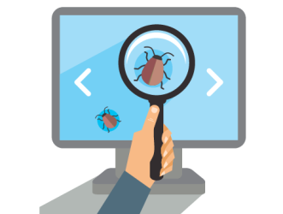



Benefits Of DEV OPS
Span the entire delivery pipeline
Improved deployment frequency
Reduce the time in every new release
Maximize the predictability, efficiency, security, and maintainability
DevOps approach grants developers more control of the environment

Slide 7
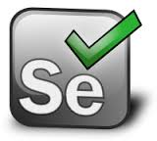

Dev Ops Services
Deployment
Source Control
Code Review
Build
Code Quality
Deploy
Testing
Build and Release Cycle
Source code management tool :
TFS (Team Foundation Server)
Quality Assurance
(Sonar)
Testing Phase
(Selenium, MTM)
Deployment
(Jenkins)
Cloud Based Hosting and access to the application services through cloud platform
Release
Integrated Development Environment
(Eclipse)
Source Code Repository
(GIT/TFS)
Continuous Integration
(Jenkins)
Deploy
(Chef and Docker)
TEST
(Selenium)
Enabling Tools

Slide 8
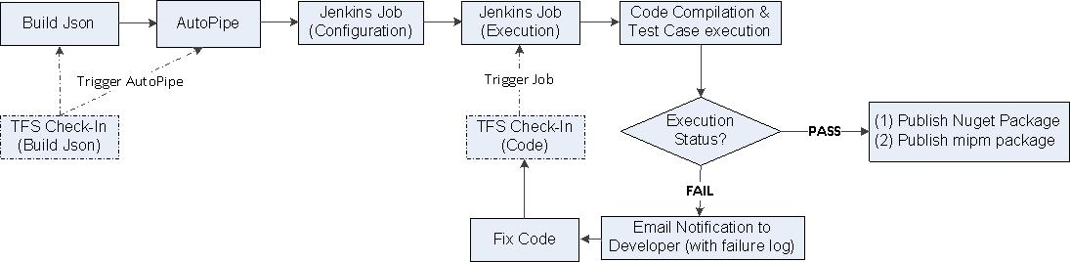







DevOps Implementation
Source Code management is TFS, all code is being build using Jenkins and deploy .
Infrastructure Provisioning
Different DevOps tools being used are OPSCODE Chef which is being used for Infrastructure management .
Jenkins is being used to achieve Continuous integration which helps to get lesser build failure.
DEPLOY
BUILD
TEST
MTM

